Slide 1
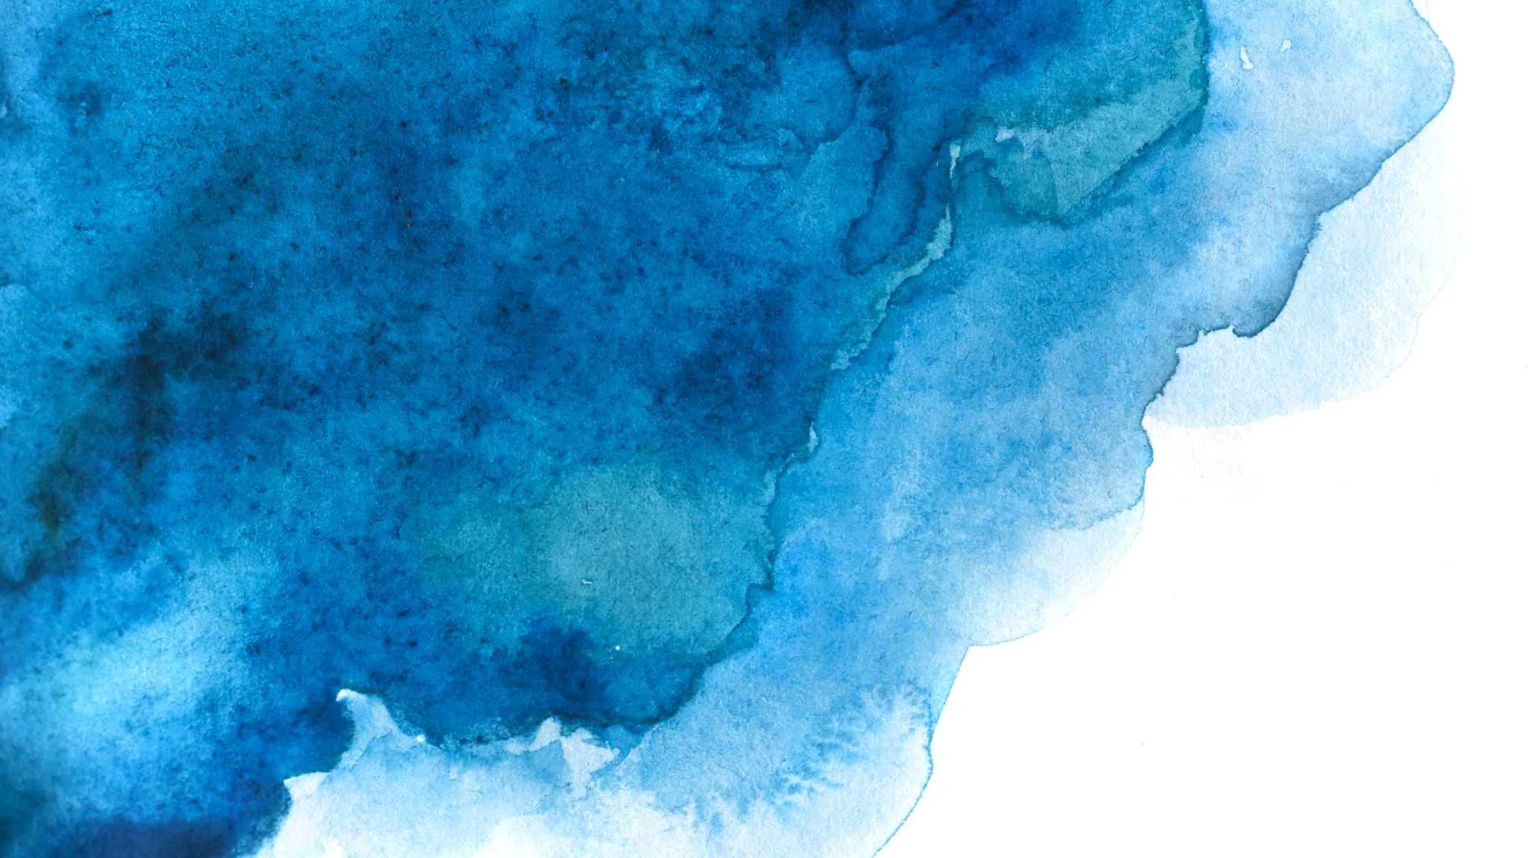
MORPHOLOGICAL OPERATIONS
Processing images based on shapes and edges

Slide 2
i) EROSION
REMOVES THE PIXELS ON THE FOREGROUND OBJECTS
cv2.erode()

Slide 3
ii) DILATION
ADDS PIXELS
cv2.dilate()

Slide 4
iii) OPENING
EROSION FOLLOWED BY DILATION
cv2.morphologyEx(img, cv2.MORPH_OPEN, kernel)

Slide 5
iv) closing
Dilation followed by Erosion
cv2.morphologyEx(img, cv2.MORPH_CLOSE, kernel)

Slide 6
v) Morphological gradient
DIFFERENCE BETWEEN DILATION & EROSION
cv2.morphologyEx(img, cv2.MORPH_GRADIENT, kernel)

Slide 7
vi) Top hat
DIFFERENCE BETWEEN INPUT IMAGE & OPENING OF IMAGE
cv2.morphologyEx(img, cv2.MORPH_TOPHAT, kernel)

Slide 8
VII) BLACK HAT
DIFFERENCE BETWEEN CLOSING OF INPUT IMAGE & THE INPUT IMAGE
cv2.morphologyEx(img, cv2.MORPH_BLACKHAT, kernel)

Slide 9
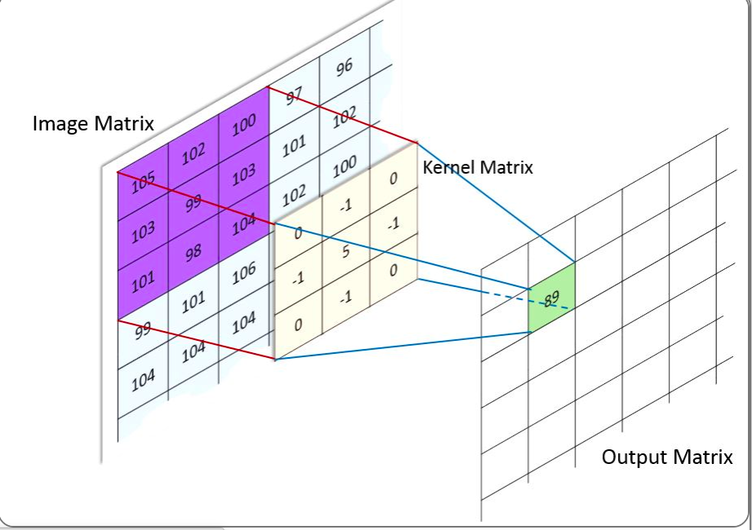
KERNEL
Changing the value of pixel
CONVOLUTION:
When the kernel is applied to every pixel in the image one-by-one to produce the final image.

Slide 10
DATA TYPES OF IMAGE
“uint” is the most used one.
Signed, unsigned, floating point….
UnSigned → No negative , Signed → Negative & Positive
If image ➔ 8-bit unsigned it is displayed as it is
If image ➔ 16-bit unsigned/32-bit unsigned, pixel → divided by 256 , range: [0,255]
If image ➔32-bit floating point, pixel → multiplied by 256 , range: [0,1]

